Slide 1

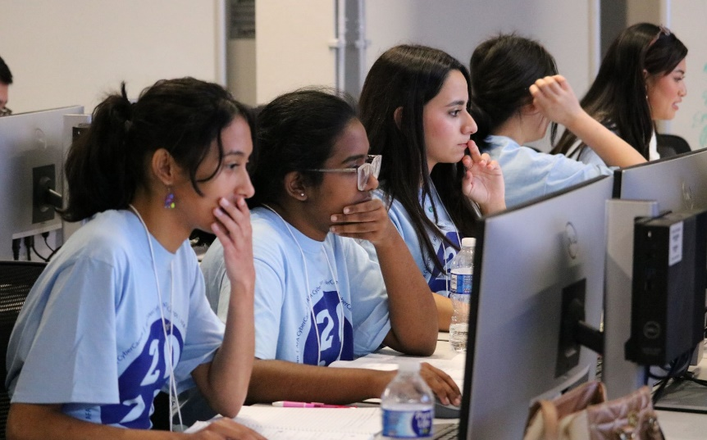
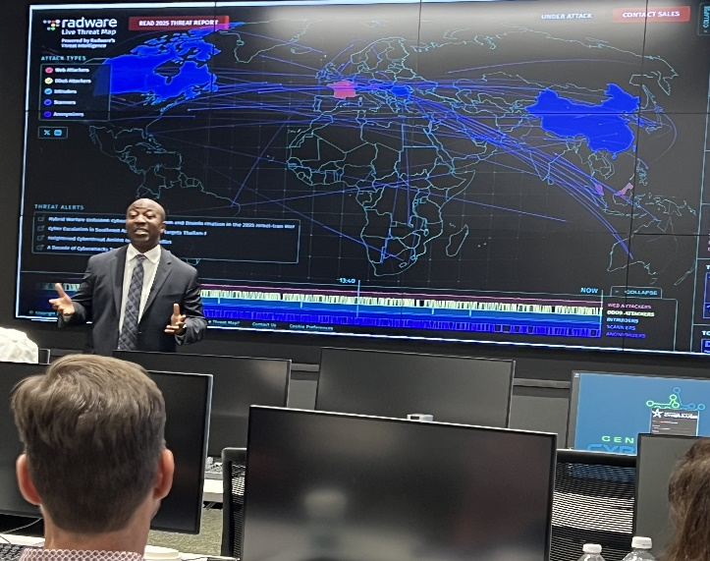
Central Texas Cyber Hub
K12 Cyber Securities Pathways Program
Cohort 1 - Kickoff meeting

Slide 2







Central Texas Cyber Hub
Congratulations on being selected to
Cohort #1
of the
K12 Cyber Security Pathways Program!
We believe that a high-quality, sustainable workforce pipeline begins in secondary education.
Please put your name, email and school in the chat window today!

Slide 3
Agenda
Agenda:
Welcome
Introduction of the CTCH Support Team
Overview of the program
Demo of the learning management system
Timeline / Next Steps
Marketing Support
Questions
Please put your name, email and school in the chat window today!

Slide 4
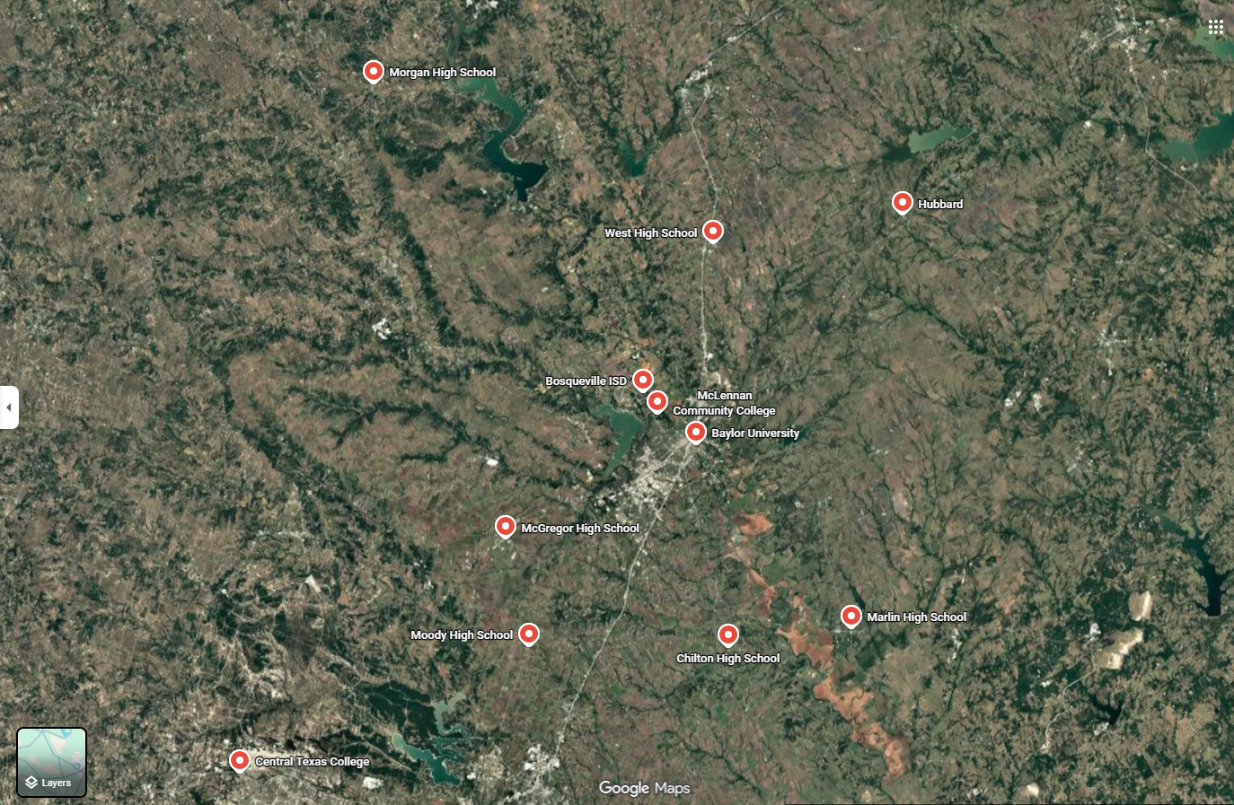
Central Texas Cyber Hub – Introductions
Welcome to the Team!!
CTCH Team: David Grover, Lauren Ralson – Baylor University
Dr. Jeremy McCormick – McLennan County Community College
Jackie VanDyke, Jeff Thompson – Central Texas College
Dr. Sari McCoy, Susan Henderson, Kelly Newman – CyberWorkforce
Richard Martin, Brazos Wortham – Scinary Cybersecurity
Keith Macik, Terry Arndt – ESC Region 12
Cohort 1:
Bosqueville High School
Chilton Secondary School
Hubbard Secondary School
Marlin High School
McGregor High School
Moody High School
Morgan School
West High School

Slide 5
Central Texas Cyber Hub – Pathways Overview
Courses | 2026-2027 | 2027-2028 | 2028-2029 | 2029-2030
Principles of Information Technology (9th grade) | Cohort 1: | Cohort 2: | Cohort 3: | Cohort 4:
Foundations of Cybersecurity (10th grade) |  | Cohort 1: | Cohort 2: | Cohort 3:
Networking/ Digital Forensics (11th grade) |  |  | Cohort 1: | Cohort 2:
Cybersecurity Capstone (12th grade) |  |  |  | Cohort 1:
LMS Demo
Cyberworkforce – Kelly Newman

Slide 6
Central Texas Cyber Hub – Timeline of Activity
September – Introductory Conversations with Public and Private K12 Institutions
October – Applications for Cyber Programming for 26-27SY
November – Selection of Cohort
December – Cohort Kickoff, POC identification, Marketing, Course Catalog inclusion
January – Course Catalog inclusion, Event Scheduling, Course Selection Fairs, Student and Family Engagements
February – March – Student Enrollment and Teacher Selection, Course Selection Fairs, Student and Family Engagements
March – May – Projected Enrollment; Curriculum Planning: Summer Engagement Marketing and Planning
June – August – Cohort 1 Teacher Institutes, Cyber Summer Camp
September
October
November
December
January
February-March
March-May
June-August
K12
Implementation Timeline
We will be holding monthly tag-ups to check on everyone’s status

Slide 7
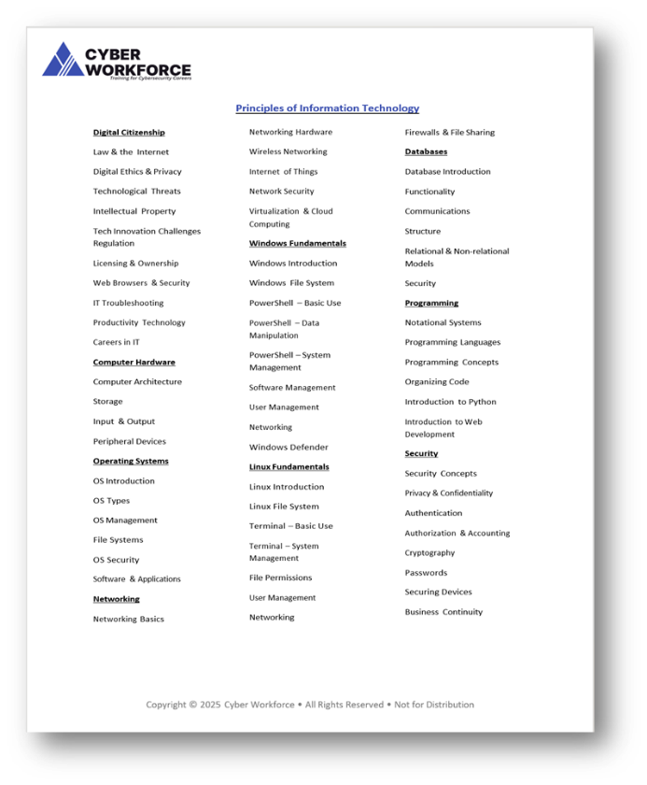
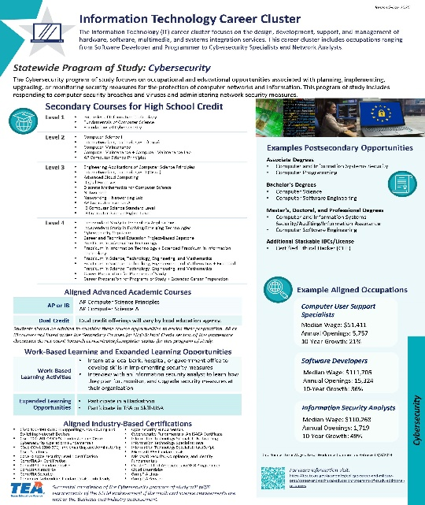
Central Texas Cyber Hub – Course Content Support
Inclusion into your course catalog:
Course Scheduling / Program inclusion:
  Program of Study alignment information?
  What do you need from us to have the course approved and included in your catalogs for 26/27?
    Cohort 1 26/27 expectation – 9th grade Principles of IT course
  Do you need support with ISD Board approvals?
We are here to help, what resources or information do you need?
We will provide you a TEA Program Study document at the end of this meeting
We will provide a Course Description document at the end of this meeting
  https://cybersecurity.research.baylor.edu/academic-activities/k-12-programs
  Contact: Cybersecurity@baylor.edu

Slide 8
Central Texas Cyber Hub – Marketing Support
Resource Materials:
Print/Flyer: Faculty/Staff
Parent Focused
Student Focused
Program Support:
  Faculty/Staff/Counselor Awareness
    We want to bring awareness across your district employees
      How can we support you? (Email, Flyer, presentation, Q/A, etc.)
  Student/Family Engagements
    We would like to support you in reaching students/parents
      Tell us how we can do that for you, examples:
        In person support to Career Fairs, Registrations events, etc. (booth, table, Q/A session, Overview)
      Virtual support (Q/A sessions, Overviews, etc.)
  https://cybersecurity.research.baylor.edu/academic-activities/k-12-programs
  Contact: Cybersecurity@baylor.edu

Slide 9

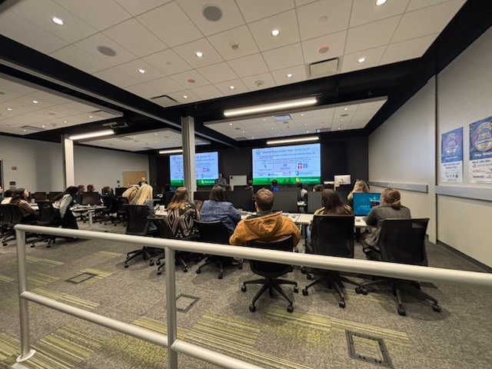

Central Texas Cyber Hub – Media Support
  Media Support
    Do you have local media that you would like support with (press releases, etc)?
    Social Media - If you post to Social Media; let us know we would love to highlight, repost, comment, etc.
    We have started a webpage for information / support; we will continue to add information, links and events
  https://cybersecurity.research.baylor.edu/academic-activities/k-12-programs
  Contact: Cybersecurity@baylor.edu

Slide 10
Central Texas Cyber Hub – What we need from you!
Ensure your main POC is correct, and we have the correct contact information
  We will be having monthly check-in’s
  Let us know who you want included in those invitations
We would like to visit each of your campus’s
  Please help us schedule a good time (Jan – Mar)
Event Requests
  Please reach out to us regarding support for your event (media, career fair, registrations, etc.)
Support needs
  We don’t know you need it, unless you ask – and chances are if you ask, someone else would like it too!
Enrollment / Registration / Catalog
  Please keep us informed on your progress
  https://cybersecurity.research.baylor.edu/academic-activities/k-12-programs
  Contact: Cybersecurity@baylor.edu

Slide 11



Central Texas Cyber Hub – Program Questions
Questions?
  https://cybersecurity.research.baylor.edu/academic-activities/k-12-programs
  Contact: Cybersecurity@baylor.edu
  David Grover
  Sr. Director, Cyber Initiatives
  Baylor University

Slide 12
Central Texas Cyber Hub – Additional Detail
Appendices

Slide 13
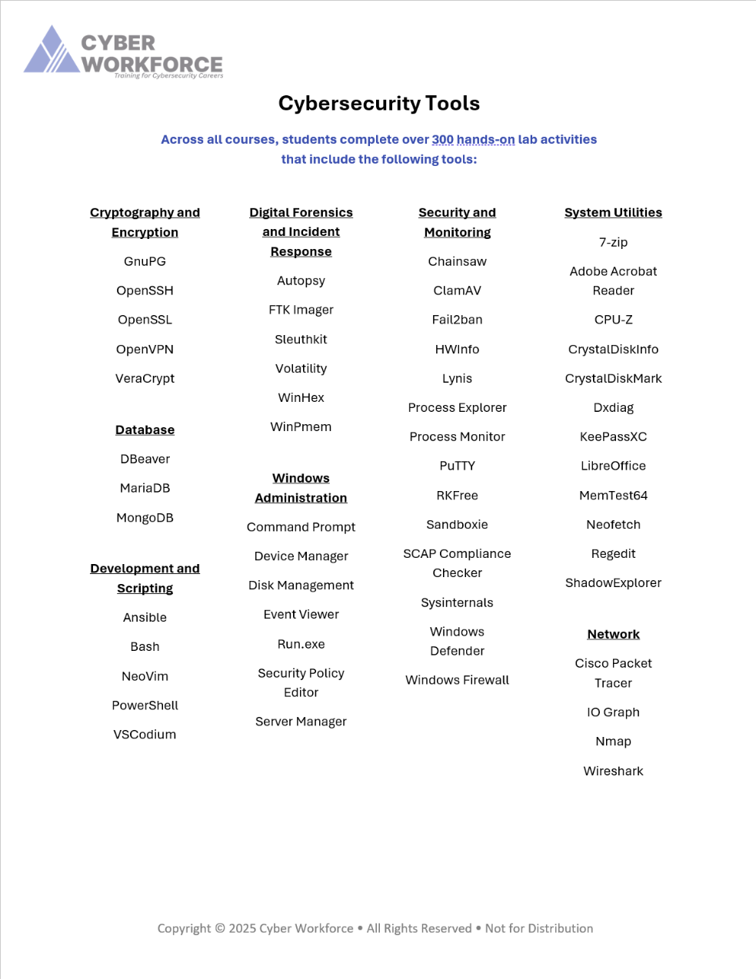

Central Texas Cyber Hub – K12 Curriculum Partnership
Cybersecurity Course Sequence:
Course 1 – Principles of Information Technology
Course 2 – Foundations of Cybersecurity
Course 3 – Critical Infrastructure & Incident Response
(Networking & Digital Forensics)
Course 4 – Cybersecurity Capstone
*Beginning in the 8th grade provides a Senior level opportunity for internships/apprenticeships/work programs
Course Elements:
5 aligned CTE courses
4 years of content
3 aligned industry-based certifications
1 cybersecurity-focused completer pathway
Applied learning in virtual ranges with Windows and Linux operating systems
Cloud-hosted content and virtual machines on a secure network
Training for Cybersecurity Careers

Slide 14
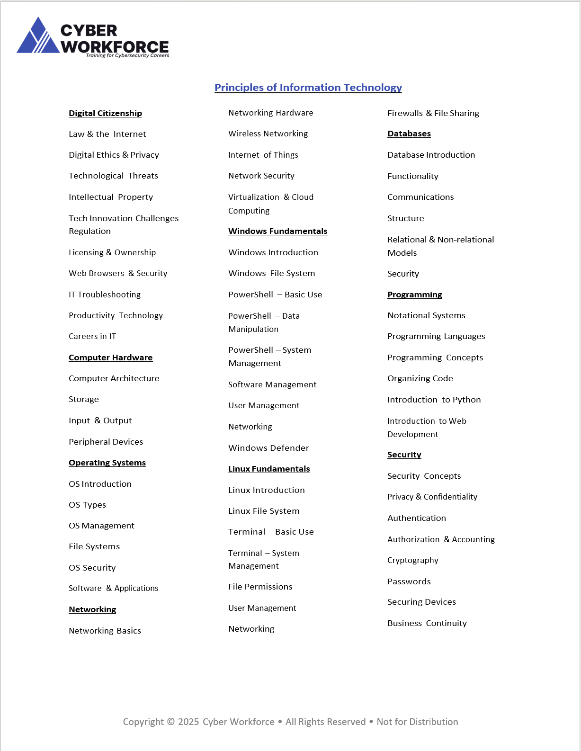
Central Texas Cyber Hub – K12 Curriculum Partnership
Course 1:
Principles of Information Technology
This course initiates learners into the foundation of computing, where they explore essential concepts such as hardware, networking, operating systems, and security.
Course Elements:
Modules: 9
Lessons: 63
Virtual Range Labs: 59
Quizzes: 63
Exams: 21
Certification Alignment:
CompTIA ITF+/Tech+
Training for Cybersecurity Careers

Slide 15
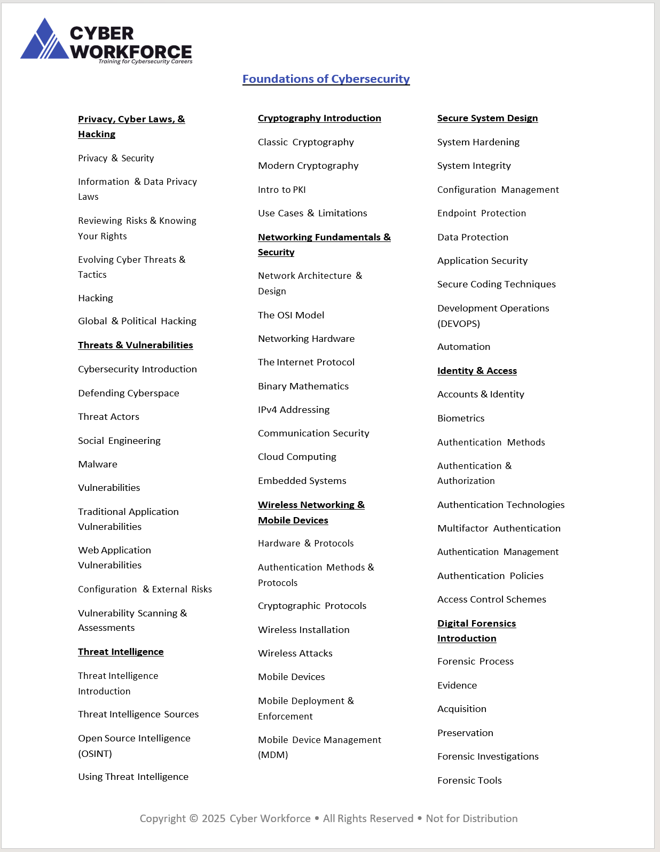
Central Texas Cyber Hub – K12 Curriculum Partnership
Course 2:
Foundations of Cybersecurity
Delve into the crucial aspects of digital protection, privacy, threat detection, and network security. This course builds a robust framework for identifying and mitigating digital vulnerabilities.
Course Elements:
Modules: 9
Lessons: 65
Virtual Range Labs: 58
Quizzes: 65
Exams: 21
Certification Alignment:
CompTIA Security+ part A
Training for Cybersecurity Careers

Slide 16
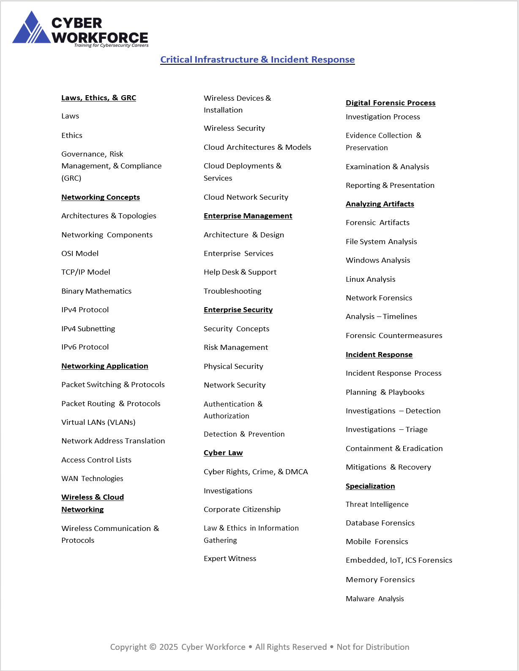
Central Texas Cyber Hub – K12 Curriculum Partnership
Course 3:
Critical Infrastructure and Incident Response
This specialized course prepares learners to manage and secure enterprise networks, emphasizing the importance of governance, risk, and compliance, alongside practical skills in network security, cloud solutions, digital forensics, incident response, and cyber law.
Course Elements:
Modules: 11
Lessons: 60
Virtual Range Labs: 52
Quizzes: 60
Exams: 20
Certification Alignment:
CompTIA Networking+
Training for Cybersecurity Careers

Slide 17
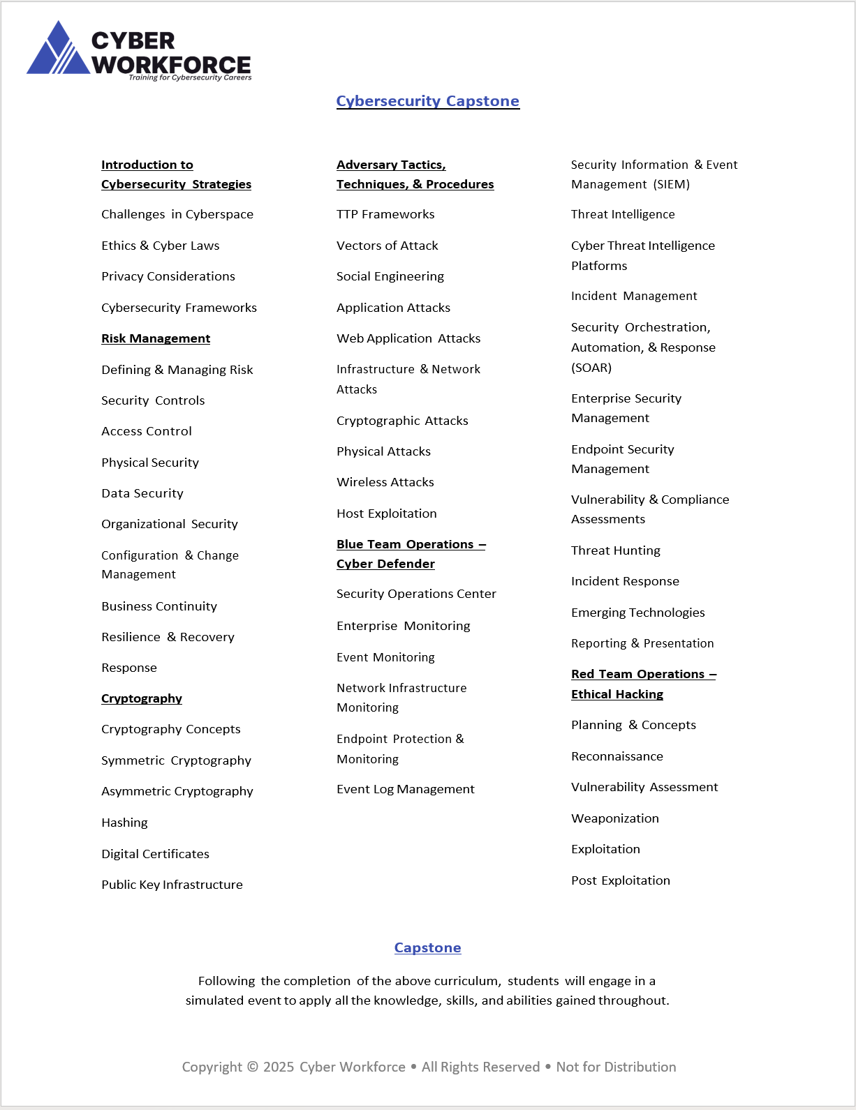
Central Texas Cyber Hub – K12 Curriculum Partnership
Course 4:
Cybersecurity Capstone
This course integrates concepts and provides learners with the ability to apply their knowledge in dynamic scenarios, including risk management, cryptography, and ethical hacking.
Course Elements:
Modules: 6
Lessons: 52
Virtual Range Labs: 50
Quizzes: 52
Exams: 16
Certification Alignment:
CompTIA Security+ - part B
Training for Cybersecurity Careers

